Slide 1
Final Revision Notes
Final Exam : Wednesday 3rd June 2015

Slide 2
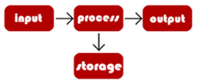
Fundamentals
Legal
Data Protection Act
Keep Personal data secure
Keep Personal data Accurate
Keep Personal data for a specific purpose
Computer Misuse Act
Illegal to access computer material without permission,
Illegal to access computer material without permission and with intent to commit criminal offences,
Illegal to alter computer data without permission
Enviromental
Advantages
Using email and working electronically means that less printing is required, and so less paper is used
using video conferences can reduce the need for people to travel to meet each other, and so less fuel is used
people can work from home - which reduces commuting (less fuel is used) and means that less office space is needed
Dis-Advantages
Computers require electricity. Tablets and mobile phones use less energy than desktops and laptops as the hand-held devices use flash memory instead of hard drives and RISC CPUs instead of CISC CPUs.
Technological waste - also known as e-waste - sometimes contains poisonous chemicals and can be an environmental hazard.
Computer Systems
Defined as having:
Input
Process
Output
Storage
Collection of Hardware and Software that work together to perform a task
Modern Computers (Embedded machines)
Washing Machines
Cars
Contactless Card Payments
Cashless Catering
Self-Service Checkouts.
Need for Reliability
Things that could go wrong:
hardware failure,
software can contain bugs and errors
human error
malicious, deliberate damage to a system
natural disasters and accidents
Reliability is a major concern for companies. There can be serious consequences, including:
loss of revenue
dissatisfied customers
damage to reputation
fines for breaking the law
Things that can be done:
Backup
Disaster Recovery
Redundancy – Having extra resources
Fault Tolerant Design
Standards are an agreed way of doing things. Standards make it easier for people to build programs and software that work on different systems in different countries.
Advantages
Produce compatible products
Easier to work with other people if you work to the same standards.
Ethical
Privacy
Google’s Street View caused controversy when it was launched after people said that taking photos of their houses was an invasion of privacy
Social networking sites, like Facebook, have made it easier to share information but have made it difficult to set privacy settings.
You can now be tracked using GPS technology and Facebook places!
De Facto Standards have been accepted as the best standard for their purpose
Industry Standards – Standards accepted as the best standards for their purpose within an industry.
Open Standards – Can be used by anyone.
Proprietary Standards – owned by organisation or individual. Controlled by licence agreement.

Slide 3
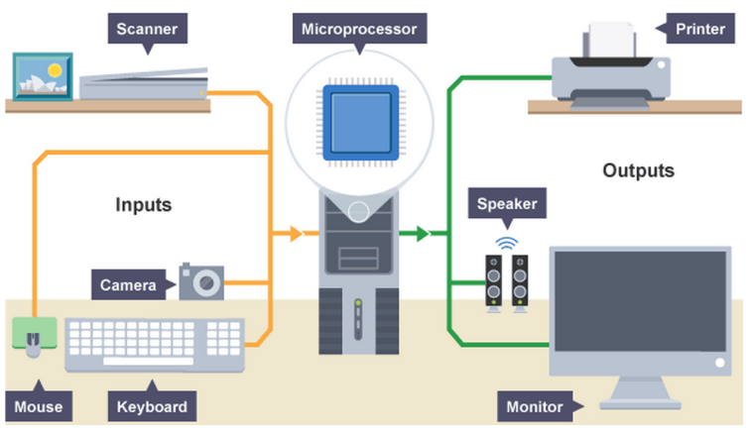
Hardware
The physical parts of a computer and related devices.
CPU
Fetches instructions (from memory)
Fetches data (from memory)
Decodes instructions
Executes instructions
Clock Speed
Represents the number of fetch execute cycles / instructions the CPU can process in a given time
The higher the clock speed the faster the CPU will run
Cache Size
The holding area for data from the RAM
The more cache the CPU has the less time is spent accessing memory / programs run faster.
Number of Cores
Number of Independent processors within the CPU.
Multiple Instructions able to be processed simultaneously in the same cycle
Quad Core = 4 cores. Can perform 4 instructions at same time in same cycle.
Devices for Disabled
Puff Suck Switch
Foot Mouse
Eye Tracker
Muscle Twitching
Input Devices
used to enter data into the computer
Keyboard / Mouse
Microphone
Touch Screen
Scanner / Camera
Joystck
Buttons
Output Devices
used to present information/the result of processing to the user
Screen
Speaker
Printer / Plotter
Storage Devices
used to store data (in binary format for processing later)
Hard Drive
Flash Drive
CD ROM
DVD
ROM (Read Only Memory)
Contains Bios which starts the operating system when computer is booted up.
Is Non-Volatile Memory – Contents cannot be changed and when computer turned off, contents is not lost from memory
RAM (Random Access Memory)
main place for storing instructions and data whilst a program is being executed.
Is Volatile Memory – when computer turned off, contents is lost from memory
Larger RAM – More Instructions can be held without need of virtual memory – faster processing
Magnetic (eg Hard Drive)
Very Large capacity
relatively cheap
Optical (eg DVD / CD Rom)
Cheap to produce
Portable
Universally readable by a most computers
Solid State (eg Flash Drive)
No Moving parts so not sensitive to being moved around while used
Quick access (for instant on)
Bit = Single 1 or 0
Nibble = 4 Bits
Byte = 8 Bits
Kilobyte = 1024 Bytes MegaByte = 1024 KB
Gigabyte = 1024 MB
TeraByte = 1024 GB
Cache Memory
Found on the CPU and is used to make the computer faster.
Instructions copied from RAM to Cache before being executed by CPU.
The larger the cache the faster the processing speed.
Virtual memory
a section of volatile memory created temporarily on the storage drive.
It is created when a computer is running many processes at once and RAM is running low.

Slide 4
Data Representation
Images
Stored as Bitmap file.
Each Pixel of Image is made up of a 1 or 0.
Following information about image is stored in file:
Width of the picture in pixels.
Number of bits used for each pixel
Colour of each pixel.
Image Resolution = The concentration of pixels
Higer Resolution = More Pixels = Larger File Size
Lower Resolution = Less Pixels = Smaller File Size.
Denary to Binary Conversion
Write out the column headings (128,64,32,16,8,4,2,1)
Work out how to make the denary number from those columns.
Binary to Denary Conversion
Write out the column headings (128,64,32,16,8,4,2,1) over the binary number.
Add all the column headings in which there is a 1
Why Use Binary.
So that computers can be based on logic circuits.
(each part of the circuit) can be in one of two states
0 and 1/true or false
Sound
The height/amplitude of the sound wave is measured
at regular intervals
and converted to binary.
If the interval is smaller
More samples taken
more data to store
larger files
the sound reproduced is closer to the original - better quality.
Binary Addition
0 + 0 = 0
0 + 1 = 1
1 + 0 = 1
1 + 1 = 0 Carry 1
1 + 1 + 1 = 1 Carry 1
If the result of the addition has a 1 in the 9th bit then Result cannot be held in 1 byte (8 bits) so will need to have a 2nd Byte.
This is an OVERFLOW ERROR.
Bit = Single 1 or 0
Nibble = 4 Bits
Byte = 8 Bits
Kilobyte = 1024 Bytes MegaByte = 1024 KB
Gigabyte = 1024 MB
TeraByte = 1024 GB
Denary to Hex Conversion
Convert to Binary
Take each digit and convert into HEX
Binary to Hex Conversion
Split Binary Number into 2 nibbles (4 bits)
Convert each nibble separately into Hex
0 A
B
C
D
E
F
Ascii
Each character is given a binary code
Uses 8 Bits
Text is stored as a series of bytes (1 per character)
Some codes are reserved for control characters (eg TAB, Carriage Return)
Character Set
All the characters which are recognised/can be represented by the computer system
Unicode
Unicode has a much larger character set
can represent many more characters/characters from all alphabets
uses 16 bits
Why use HEX instead of Binary
Binary produces long strings/ Hex is shorter
Binary is difficult to work with/Hex easier to work with
Hex can be easily converted to/from binary / 1 hex digit per nibble
·Hex is less susceptible to error
(

Slide 5
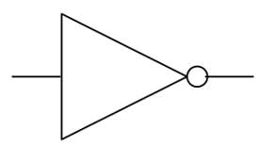
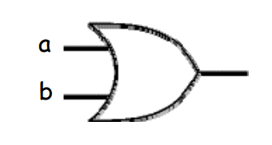
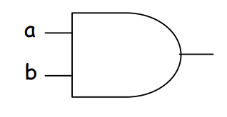
Binary Logic Gates
IN | OUT
0 | 1
1 | 0
Not Gate
Flips the input (0 becomes 1 and 1 becomes 0
A | B | Out
0 | 0 | 0
0 | 1 | 1
1 | 0 | 1
1 | 1 | 1
OR Gate
Wait for either inputs to be 1 for output to be 1
A OR B
A | B | Out
0 | 0 | 0
0 | 1 | 0
1 | 0 | 0
1 | 1 | 1
AND Gate
Both inputs to be 1 for output to be 1
A AND B

Slide 6
Software
Off-the-shelf software
Designed to provide a general set of features that a broad range of customers will find useful.
Advantages
Available Immediately.
Tried & Tested. Less likely to contain bugs.
Costs Less than Custom Written
Dis-Advantages
May contain unnecessary features.
May not be compatible with current hardware
Custom Made software:
specially designed and written for a single organisation or group of users.
Might decide to used because:
Appropriate software may not exist
Existing software may not be compatible with current hardware
Existing software may contain additional features (more complex and expensive)
Operating Systems
Memory Management
Controls where the programs go in memory when being run.
User Interface
Provides a method of interaction with the user. MultiTasking
Allows more than one program to run at once by sharing CPU time between programs.
Peripheral Management
Manges all Input, Output and Storage devices.
Security
Protects the machine is free from harmful viruses or unwanted access.
Open source software
free and openly available to everyone. No licence needed.
The code is published and allow others to use and modify it.
Open source products are usually tested in public by online contributors.
Proprietary software
legally remains the property of the organisation, group, or individual who created it.
Source code not usually published.
Aspecial licence key needs to be purchased to use it.
AntiVirus
Scans the computer periodically
• To check if any software has been installed which contains code that may harm the computer
• Removes/quarantines these programs / notifies the user
• Prevents these programs from being installed
• Protects the computer by preventing important files (eg the boot sector or operating system) from being changed
System Cleanup
(Searches for and) deletes files/programs which are no longer used
… eg deletes temporary files / installation files
… deletes settings / registry values which are no longer used
System Information Utility
displays important data about the current state of the computer
· e.g. temperature, free memory, network speed, % processor used
Automatic Update
Checks on the (software manufacturer's site on the) Internet for newer versions of programs which are installed
• If found it download / installs the software
Diagnostics Utility
attempts to detect/resolve items that are not working correctly
· e.g. missing drivers, network connection
Disk Defragmenter
Moves (parts of) of files around so that all parts of a file are stored together (allowing files to be accessed more quickly)
• Free space is collected together (allowing large files to be saved easily)
Firewalls
will block unexpected connections coming in to the network.

Slide 7
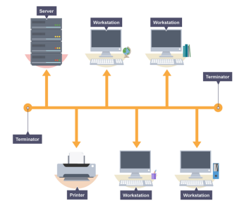
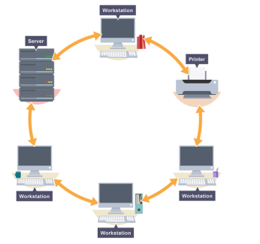
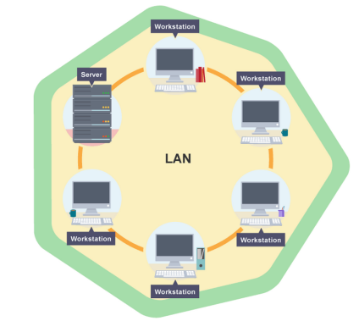
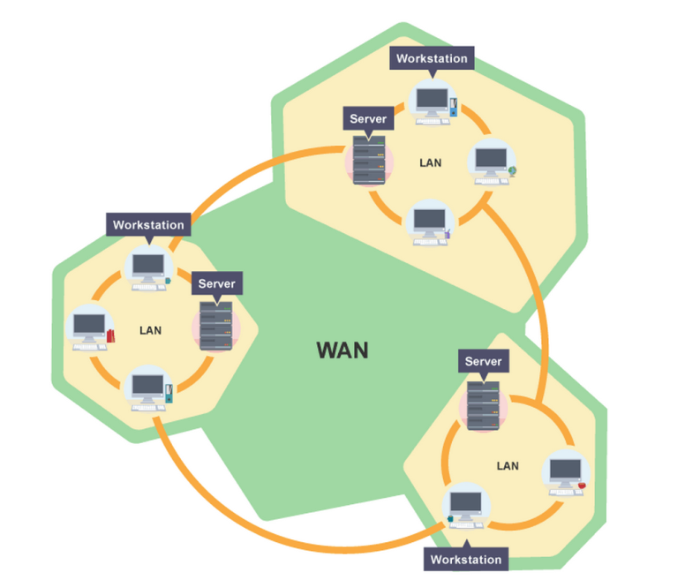
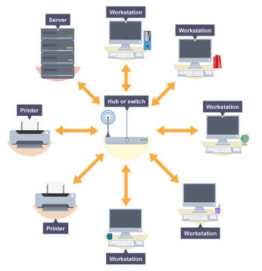
Networks
Bus
All the workstations, servers and printers are joined to one cable - 'the bus'. At each end of the cable a terminator is fitted to stop signals reflecting back down the bus.
Advantage
cheap to install - it does not require much cabling
Disadvantage
If the main cable fails or gets damaged, the whole network will fail
As more workstations are connected, the performance of the network will become slower because of data collisions
Network
A collection of computers connected together.
LAN
Network over a local geographical area (eg School)
WAN
Network over a large geographical area (eg WWW)
Advantages
Share Internet Connection
Share Peripherals
Share files
Sends Emails
Dis-Advantages
Risks of Viruses and Hacking
Expensive Hardware
Specialist staff often needed (eg Network Manager)
Ring
Each device (eg workstation, server, printer) is connected in a ring so each one is connected to two other devices. Each data packet on the network travels in one direction. Each device receives each packet in turn until the destination device receives it.
Advantage
Transfer data quickly (even if there are a large number of devices connected) as data only flows in one direction so there won't be any data collisions
Disadvantage
If there is one break in the ring then the network breaks down.
Star
Each device on the network has its own cable that connects to a switch or hub.
Advantage
very reliable – if one cable or device fails, then all the others will continue to work
high performing as no data collisions can occur
Disadvantage
expensive to install as this type of network uses the most cable, and network cable is expensive
if a hub or switch fails, all the devices connected to it will have no network connection

Slide 8
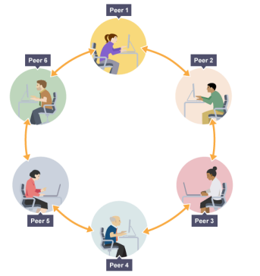
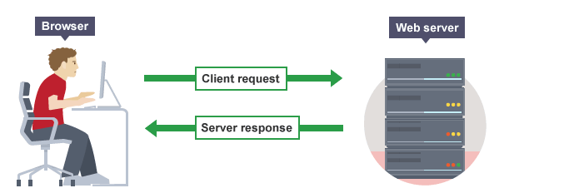
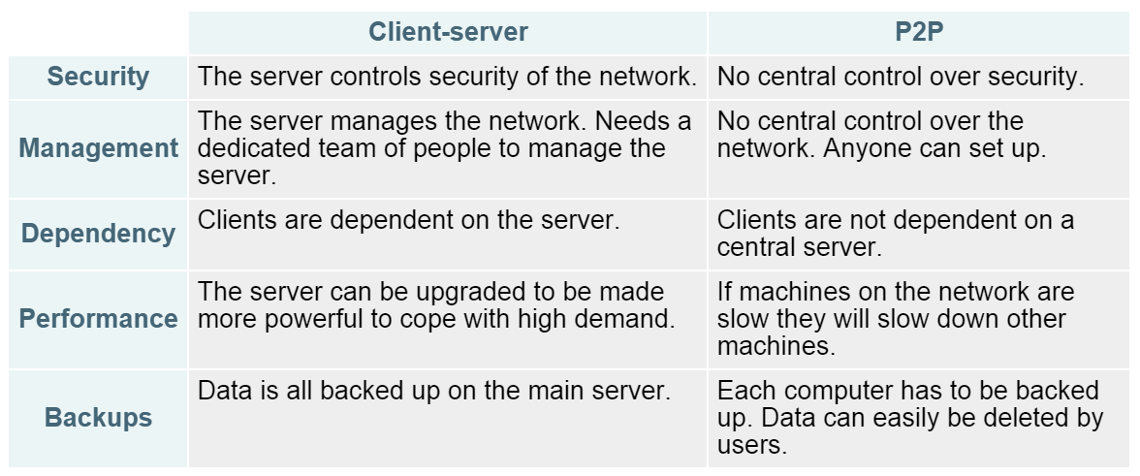
Networks 2
Peer To Peer
No single provider is responsible for being the server. Each computer stores files and acts as a server. Each computer has equal responsibility for providing data.
Client Server
The client-server model is the relationship between two computers in which one, the client, makes a service request from another, the server. For example, websites are stored on web servers. A web browser is the client which makes a request to the server, and the server sends the website to the browser.
Hardware
Hub – used to connect multiple devices to the network.
Switch – connecting computers and other network capable devices together to form a network.
Server – A computer that holds data to be shared with other computers. A web server stores and shares websites. Servers require server software.
Router / Modem – Connects Server to Internet
Security
Anti Virus Software – Scans the system for viruses.
Firewalls – will block unexpected connections coming in to the network.
Strong Passwords – When more than one person uses a network it is important to have user IDs and passwords. Only someone with a login and password can access that network.
Access Levels – Different users have different access to parts of the network. Eg General Users will only be able to use software whereas higher users may be able to download software.
Encryption - Any message sent over a network can be intercepted. Encryption is a method of changing the original numbers and characters so that they are hidden or disguised. This is important if you are sending sensitive information.
Network Policies
Acceptable Use Policy – states how the network may be used – what is and is not acceptable.
Disaster recovery - In the event of the system failing there needs to be plans in place to get the network up and running again as quickly as possible.
Failover and backups – If there is a power cut, there are UPS (Uninterrupted power supplies); If a hard drive fails, there is usually a backup
Of the data on the network

Slide 9
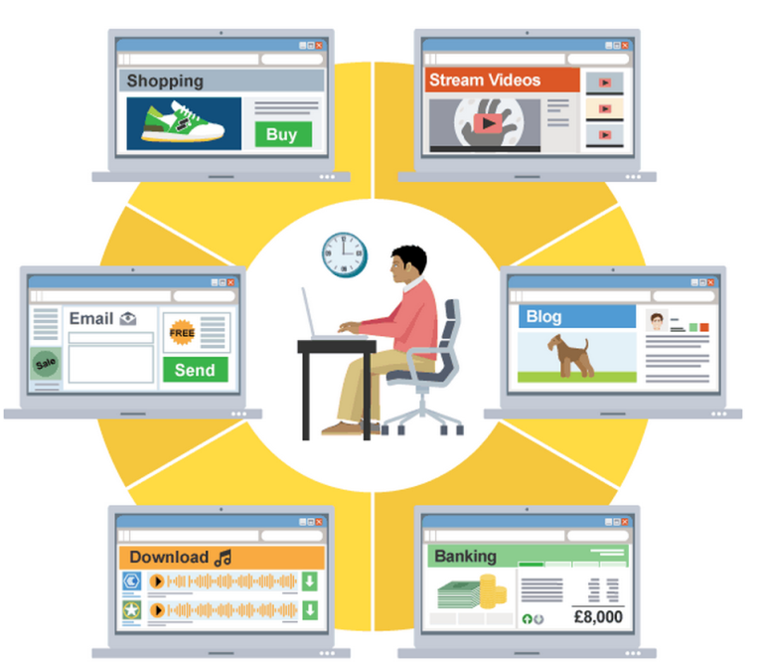
Internet
Internet is a global network of computers that any computer can join. It is a network between many Networks (ie WAN).
It is NOT the same as the World Wide Web.
HTML (HyperText MarkUp Language)
The language used to write and display web page documents.
HTML can do several things:
set where text should be placed
describe how text should look
create hyperlinks
embed images
create sections within the page
Importance of HTML in Creating Web Pages
Web browser used to interpret the file and display the data correctly
• Because it is an open/accepted standard...
• ... data will display correctly on all browsers
• ... which conform to the standard
DNS (Directory of ALL Web Page Addresses)
How DNS servers are used:
DNS servers have a database of IP addresses
Constantly updated by other DNS servers
When you request an address(URL), the DNS server looks up the URL and returns the IP address, or searches for the address from other DNS servers
Advantages
People do not need to remember IP addresses
Easily upgradable (eg IPv4 toIPv6) without all web addresses needing to be the same
As long as you are connected to a DNS server you can have access to all the addresses
File Format | Type
AVI / MPEG | Video
BMP / JPG | Image
MP3 | Audio
PDF | Text Files
Zip | Compressed Files
HTML | Web Pages
File Compression
It reduces the size of the file which needs to be transmitted
• Shortens download time
• Reduces Internet traffic (and hence probability of lost packets)
• Allows multimedia files to be streamed
LossLess Compression
When the data is uncompressed it is restored completely to the original file
E.g. compressed text files.
Lossy Compression
When the data is uncompressed it is not exactly the same as the original but the difference is so small that it cannot normally be noticed
E.g. music files(mp3), large resolution images for displaying on small screens.

Slide 10
Database
Validation
Makes sure the data entered is correct
Range Check – Ensures the data is within two values eg age
Presence Check – Ensures data exists eg Email address
Type Check – Ensures data is of a certain type eg Gender
Length Check – Ensures data entered is of certain length eg Password
Database
A persistent...
• ... and structured/organised store of data
• Allows data to be queried/interrogated.
DBMS
A DataBase Management System/Used to manage the database
• May use SQL/allows database to be queried
• Provides facilities for creating tables/inserting data/viewing data/reporting
• Allows data structure to be independent of the program
• Allows relationships to be created between tables/Maintains integrity
• Provides security features/levels of access
Entity – Real world thing about which data is held. (Another name for a table).
Relational Database – when the data is separated into individual tables (entities) that are linked by a primary key (which appears in each table). Primary Key is a UNIQUE identifier for each table. Usually ID fields.
Primary Key links with Foreign Key in another table to make a relationship.
The advantage of separating the data into different entities is to avoid data redundancy – when the same data is stored in several places in the database
Data Types
Real - Number with decimal Point
Integer - Number without a decimal Point
Text - Characters
Date - Date and Time
Boolean - True or False / yes or no
Form – Method to enter data into the database.
Report – Printed document that contains information from the database that has been organised and presented in a specific way.
Query – Searches the database for specific information using criteria
Eg Age > 11 AND Hair = “Black”

Slide 11
Programming 1
Syntax Error
An error in the rules/grammar of the language Eg missing colon / spelling mistake
Logic Error
The program is written to do something other than what the programmer intended
Eg Resetting only the first 9 elements in an array instead of all 10.
Constant
Value that never changes
Variable
Value that can change
IDE (intergrated Development Environment)
Application used to create software (eg IDLE)
Code Editor – edits program text
Bracket Matching – Help reduce syntax errors
Syntax Checks – Highlights syntax errors
Runtime Environment – allows programs to be run one line at a time – helps test programs and locate errors.
Translator – Compiles or interprets the code
Libraries – Provides functions not included in core part of programming languages (eg Random)
Debugger – Helps to detect errors. Suggests what type of error it is and what line it is on.
Data Types
Real
Number with decimal Point
Integer
Number without a decimal Point
String
A series of characters
Character
A letter
Date
Date and Time

Slide 12
Programming 2
High Level Language (eg Python)
Use Instructions are in Words
Designed to be read by human programmers
Portable/translated for different machines
Selection
A condition is used to decide whether code should be executed
• if x = 1 then y = 3 else x = 2
Machine Code (Binary Code)
Instructions are in binary code Designed to be read/executed by the computer
Specific to a particular machine
Translators
Interpretors:
Translates one line of HL code at a time…
• … and executes it
• … stops when it finds an error
• … can be resumed
Compilers:
Translates whole program of HL code at a time…
• … and executes it
• … stops when it finds an error
Assembler:
Translates Assembly language into machine code
Sequence
A list of instructions to be followed one after the other. Step by step
Assembly Language
Low Level Language written in mnemonics that closely reflect the operations of the CPU
Eg LOAD
Iteration
code is executed repeatedly
For I in range (10);
Print (i)
Why Use Binary.
So that computers can be based on logic circuits.
(each part of the circuit) can be in one of two states
0 and 1/true or false
Array
Data Structure / Collection of several variables
Under one name
Algorithms
Write down Inputs
Input dogage
Write down Processing
If dogage > 2
Humanage = dogage * 7
Write down Outputs
Print Humanage
1 | 3 | 5 | 7 | 9 | 11
How Instructions are stored in Binary.
The instruction consists of an operator/op code and an operand
both stored as bit patterns
(op code) from a given instruction set
Each op code has a unique bit pattern

