Slide 1
Computer Networks
Lesson 3

Slide 2
Starter
Work in pairs to use the internet to answer the following questions. Type this into a document:
What is the difference between an IP address and a MAC address?
Why is data sent in packets rather than as a single block?
What does DNS stand for and what is it used for?
What does TCP/IP stand for and what is it?

Slide 3
Objective of the Lesson
Understand how computers communicate over networks.
All of you will:
Explain what an IP address is used for.
Most of you will:
Identify the difference between an IP address and a MAC address and how a DNS translates IP addresses.
Explain how data is sent using packets.
Some of you will:
Research how TCP/IP works.

Slide 4
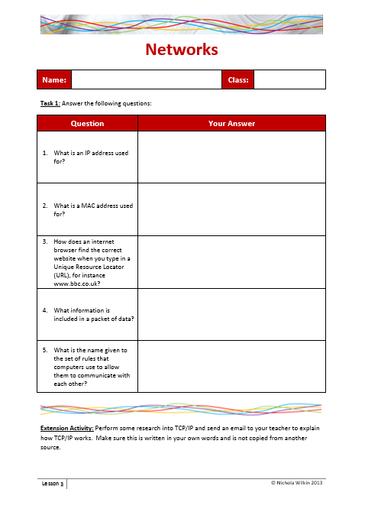
Homework
Everybody should complete Task 1 to answer the questions on the worksheet.
Some of you may also want to get the extra marks by performing some extra research into TCP/IP.
This homework is due in next lesson.
Make sure you have written your homework clearly in your planner.

Slide 5
IP Addresses
Every machine on a network has a unique number which identifies it.
Most networks today use the TCP/IP protocol as the standard for how to communicate on the network.
The TCP/IP protocol lays out the rules by which data will be transferred across the network.
In the TCP/IP protocol, the unique number for a computer is called its IP address.

Slide 6
How are IP Addresses Structured?
An IP address is made up from 4 groups of numbers, between 0 and 255, separated by a full stop:
192.168.66.145
These two numbers define the network the computer is on.
These two numbers define the individual machine number.

Slide 7
The Shortage of IP Addresses
There is an obvious flaw with this system which is that there are not enough IP addresses for the number of computers that want to use the internet.
One solution to this problem is to use two types of IP address:
Public IP addresses are totally unique and
Private IP addresses must only be unique within the local network that the device belongs to.
This way one computer on a network may have a public IP address which is connected to the internet and all the rest on that network would have private IP addresses.
Another solution is to use a bigger IP address with more numbers allowed and newer IP address have more segments, thus allowing for more unique IP addresses.

Slide 8
Finding out your IP address
Go to the following website:
http://whatismyipaddress.com/
This will tell you the IP address for the computer you are currently using.
What is similar about all the IP addresses in the classroom?

Slide 9
Using an IP Address
Open up a web browser and type the following into the URL address line.
212.58.253.67
What happens when you hit your [Enter] key?
As you have seen, it is possible to type in the IP address of the website straight into the URL bar.
As IP addresses are so difficult to understand we tend to use a more user-friendly name for the websites.

Slide 10
Domain Name System (DNS)
We have seen IP addresses are not user friendly and so we commonly use domain names to help us make sense of them:
www.bbc.co.uk
These domain names are stored in a large directory which saves the domain name and the IP address it relates to.
When a user types in a domain name, the correct IP address is looked up in the directory and then is used to find the correct website.
This directory is called the Domain Name System (DNS).

Slide 11
Domain Name System (DNS)
The DNS is stored on several large computers around the world and translates easily memorised domain names into the IP addresses which then allows the internet browser to search for the correct website.
By providing a worldwide service, the DNS is an essential part of the Internet.

Slide 12
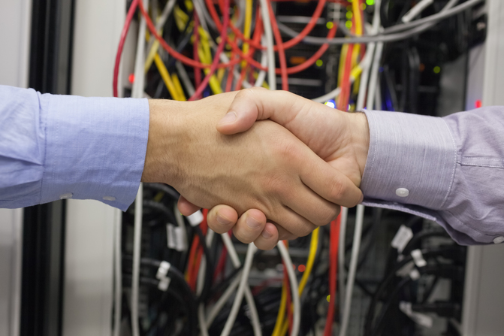
TCP/IP
TCP/IP stands for Transmission Control Protocol/Internet Protocol.
This is a set of rules used to connect computers to the Internet.
TCP/IP is the industry standard for transmitting data over networks.

Slide 13
MAC Addresses
A MAC (Media Access Control) address is a number that uniquely identifies each node (computer or other peripheral) on a LAN.
This is shown as a set of 6 Hexadecimal numbers:
C4-85-08-74-1A-62
These are programed into circuit boards when the item is built and should not be changed but can be re-programmed if a clash occurs.
These represent the manufacturer
These are automatically generated

Slide 14
Packets
Large email messages, websites and other data is often too large to send all in one large chunk over a network.
These are broken down into smaller, more manageable parts called “packets”.
Each packet carries the following information:
The sender's and recipient’s IP addresses.
How many packets the data has been broken into.
The number of this particular packet.
The relevant section of data they need to carry.
A typical packet contains around 1 to 2 KB.
When the computer receives the packets, it waits until it receives them all and then reassembles the data into the correct order.

Slide 15
Guess what I am…
You are going to play a game so please split into small groups with 3 – 5 people in each team.
You are going to see a word or phrase on the screen which will be displayed one letter at a time.
If you think you know what the word is then put up your hand and not only say what the word is but you also need to DESCRIBE what it means.
If you get the word or phrase wrong then you cannot guess again for that word or phrase.

Slide 16
Guess what I am…
N
O
D
E

Slide 17
Guess what I am…
T
C
P
I
P

Slide 18
Guess what I am…
I
P
A
D
D
R
E
S
S

Slide 19
Guess what I am…
P
A
C
K
E
T

Slide 20
Guess what I am…
M
A
C
A
D
D
R
E
S
S

Slide 21
Guess what I am…
D
O
M
A
I
N
N
A
M
E
S
Y
S
T
E
M

Slide 22
How much do you remember?
At the beginning of the lesson you answered these questions. Look at your answers and see if you can write better answers in your own words.
What is the difference between an IP address and a MAC address?
Why is data sent in packets rather than as a single block?
What does DNS stand for and what is it used for?
What does TCP/IP stand for and what is it?

Slide 23
The Internet
Click here to watch the video
Watch the video, created in 1969 about how they thought the internet could be used around the home.
Send an email to your teacher identifying how close their predictions were to what we can actually do. What did they get right and what did they get wrong?

