Slide 1
Learning Outcomes –Lesson 4
Combine maths and text
Use the Python interpreter as a calculator
Explain what is meant by the term integer

Slide 2
Paste this table into your books

Slide 3
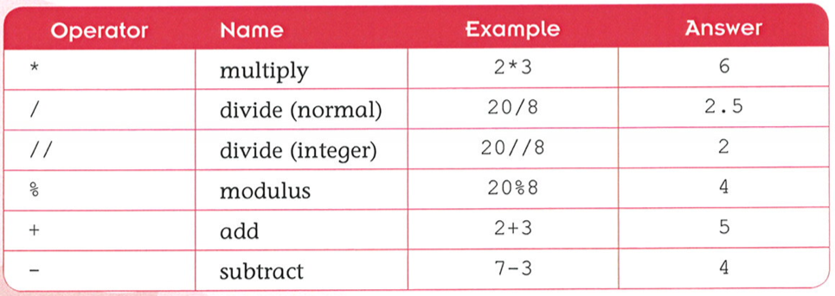
[ slide 5 ]
Maths in Python
Paste the table into your book
Key words – write these into your book leave room
to write a definition
integer
float
mathematical operator
modulus

Slide 4
Open the Python Shell ( Interactive mode) then open a "New window" (script mode) type in the following calculations:
Save the script as "simple_calculation.py" then run it (F5) If you done things correctly you should see
the answers to the calculations in the shell.
Check with the image below.

Slide 5
Maths in Python
Race a friend with a calculator to see whether Python is faster than a calculator:
5 * 6.5 =
7 / 3 =
128 + 6 =
How many times does 120 divide by 7?
What is the remainder of 120 / 7?

Slide 6
[ slide 7 ]
Combining Maths and Text
The print() function will print to screen:
strings, numbers or calculations separated by commas:
Interactive session:
What will the output from this code produce?
>>> print("11 divided by 4 = ", 11//4, "remainder ", 11%4)
11 divided by 4 = 2 remainder 3
>>> print("111 divided by 4 = ", 111/4)
111 divided by 4 = 27.75
>>> print("11 divided by 4 = ", 11/4)
11 divided by 4 = 2.75
Now try entering this code:
>>> print("I will not write code in history lessons.\n" *50)
See what else you can produce.

Slide 7
Using the Python interpreter as a calculator
Go back to the IDLE screen
What is 156 add 567?
What is 132 subtract 46?
What is 256 divided by 8?
What is 389 multiplied by 13?
Can you work out what mathematical symbols need to be used?

Slide 8
What works?
Both of these work

Slide 9
The answers – use brackets!

Slide 10
Why don’t these work?
>>> what is 2 add 2?
>>> 3 times 6
>>> 24 subtract 3
>>> How many times will 4 fit into 12?

Slide 11
Integers
In computing, whole numbers (without decimals) are referred to as integers, this means that while 4.0 is not considered an integer, 4 is.
It is possible to store integers into variables.

Slide 12
Integers stored into variables

Slide 13
Evaluating expressions

Slide 14
Learning Outcomes Lesson 4
Combine maths and text
Use the Python interpreter as a calculator
Explain what is meant by the term integer

