Slide 1
Computer Networks
Lesson 2

Slide 2
Starter
Work in pairs to answer these questions:
What is a network?
What is the difference between a LAN and a WAN?
Describe an advantage of using a ring network.
Describe a disadvantage of using a ring network.
Describe an advantage of using a bus network.
Describe a disadvantage of using a bus network.
Describe an advantage of using a star network.
Describe a disadvantage of using a star network.

Slide 3
Objective of the Lesson
Identify the hardware involved in a network.
All of you will:
Describe at least 3 pieces of hardware that are needed in a network.
Most of you will:
Identify most pieces of hardware which are needed in a network.
Explain the difference between a peer-to-peer and a client-server network.
Some of you will:
Identify advantages and disadvantages of peer-to-peer and client-server networks.

Slide 4
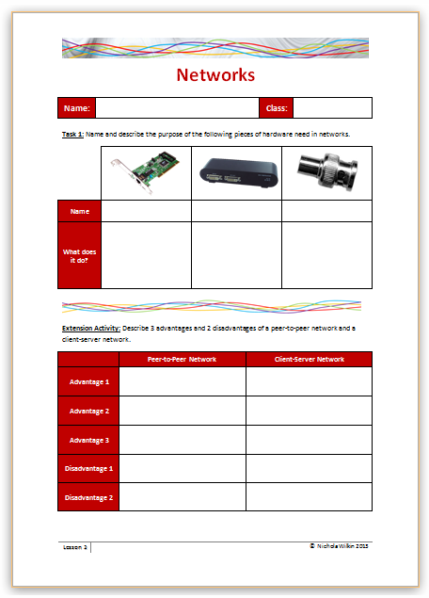
Homework
Everybody should name and explain what the different pieces of hardware are used for in a network.
Some of you may also want to get the extra marks by describing 3 advantages and 2 disadvantages of a peer-to-peer and a client-server network.
This homework is due in next lesson.
Make sure you have written your homework clearly in your planner.

Slide 5
Creating a Network
In order to create a network, there are many pieces of hardware that you need to be familiar with.
Apart from the computers, peripherals and cabling what other pieces of hardware do you think you need?
Work in pairs to write down a list of the main hardware that you think you need and explain what you think that piece of hardware does.

Slide 6
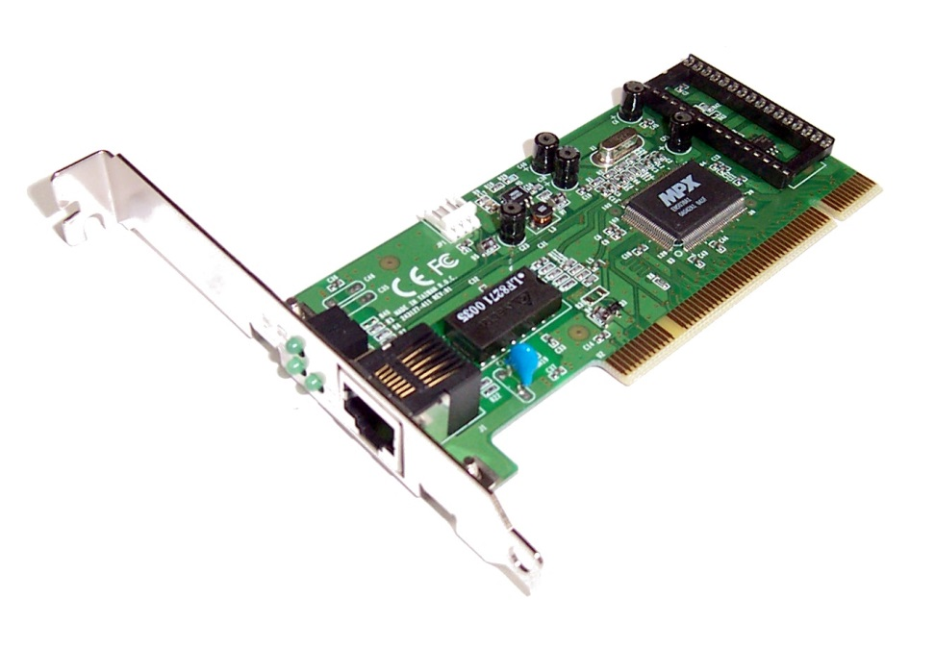
Network Interface Card (NIC)
This used to be a separate card as shown. As many computers these days need access to a network, the technology is often built into the motherboard, especially on laptops.
The NIC is used to prepare and generate the signals to be transmitted over the network.
Most NICs are designed for a particular type of network and cabling although some can work over multiple networks.
Look at a computer and try to see the connection for the network cable. This is part of the Network Interface Card.

Slide 7
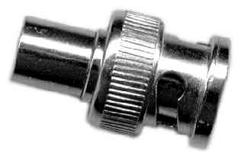
Terminator
On a bus network a terminator is used at each end of the bus to absorb signals so that they are not “bounced back” along the line.

Slide 8
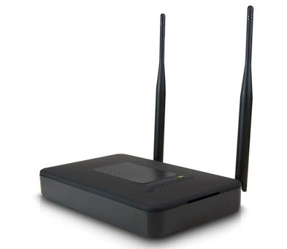
Repeater
In networks that use ethernet cables or Wi-Fi, data can only travel a limited distance before the quality of the signal weakens.
Repeaters boost the signal to extend the distance over which data can safely travel.

Slide 9
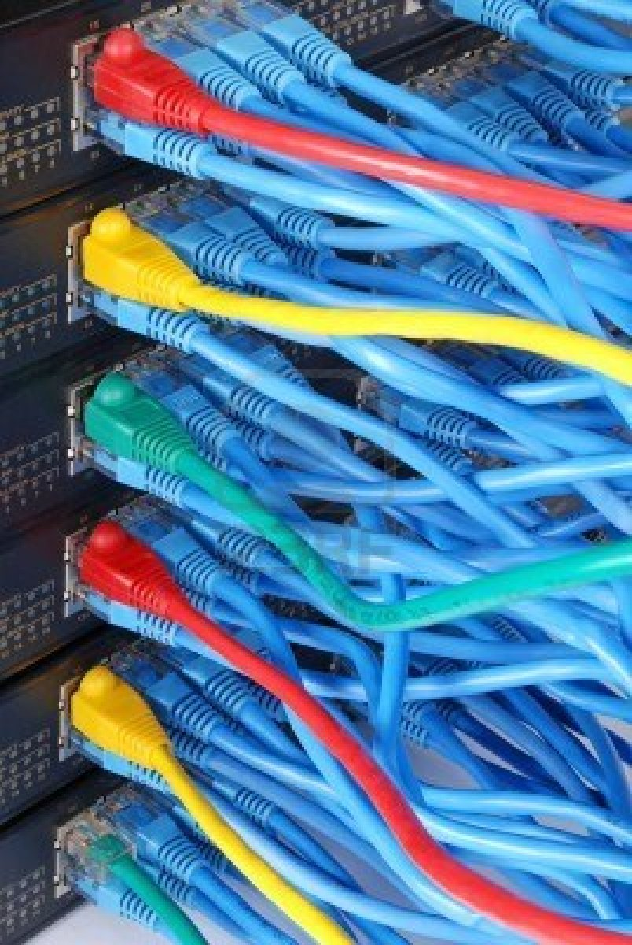
Hub
Hubs are a type of repeater but allow more than one output.
When the hub receives a message it boosts the signal and sends it to all computers connected to it but only the intended recipient will actually process it.

Slide 10
Switch
Switches are very similar to hubs, but a switch is also capable of inspecting incoming messages as they are received, determining the source and destination device of each packet, and forwarding them to the correct computer rather than sending them to all the computers.

Slide 11
Bridge
Often networks are linked together and a company may have more than one local area network (LAN) .
A bridge is a product that connects one LAN to another LAN that uses the same protocol .
The bridge examines each incoming message and either allows the message to be passed onto the correct recipient or forwards the message to another LAN.

Slide 12
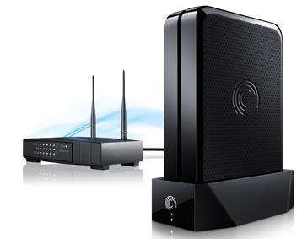
Router
A router allows messages to be sent between different types of network.
For instance, it could transfer a message from a LAN using a Wi-Fi system and send the message onto the internet which is a WAN.

Slide 13
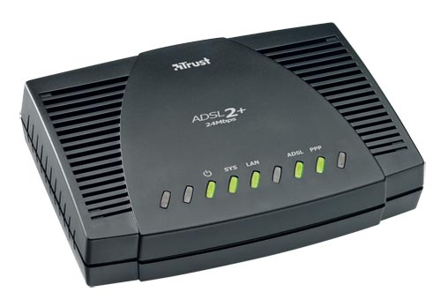
Modem
A modem (modulator-demodulator) used to be used to convert messages from a digital signal that a computer uses to an analogue signal that were used on telephone lines.
It would then convert the signal back from analogue to digital when the message reaches its destination.
These were traditionally built into many computers but are now fairly obsolete as most cabling (including telephone lines) now uses digital systems so there is no need to translate analogue signals.

Slide 14
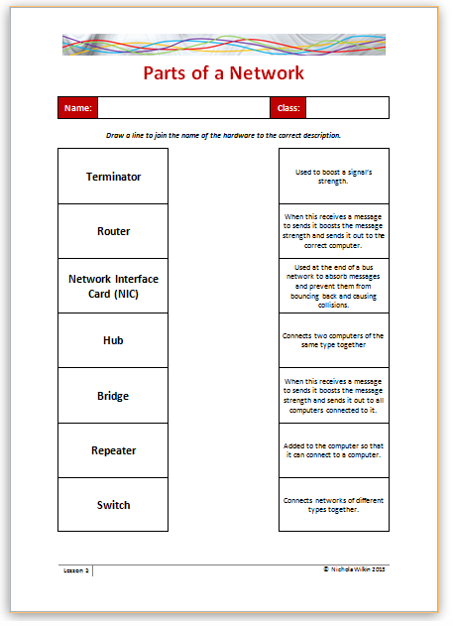
Parts of a Network
Draw a line between the piece of hardware with the correct description.

Slide 15
Types of Network
There are two types of network you need to be aware of:
Peer-to-peer
Client-server
These two types of network explain how data is stored and retrieved on a system rather than the shape or size of the network.

Slide 16
Peer-to-Peer Network
In a peer-to-peer network, all the computers are equal and act as an administrator.
There is no central server but a peer-to-peer network usually uses a hub so that messages can be broadcast to all the computers on the network.
If Computer A wants to access files on Computer B then Computer B needs to set up the permissions to allow this to happen.

Slide 17
Peer-to-Peer Network
Most operating systems allow users to set up a peer-to-peer network. They are quick to set up and are usually used for small, temporary networks.
There are disadvantages of using a peer-to-peer network as it is up to each user to set up their own security so there is no network-wide security.
They can also become chaotic and slower the larger they become and it is difficult to keep track of who has access to which other computer.

Slide 18
Client-server
A client-server network is far more common than a peer-to-peer network.
Instead of all the computers being equal and responsible for allowing others to access the files on their machine, all the files are stored in a central location and access is controlled centrally.
Each user needs a user ID and password in order to access the network.

Slide 19
Client-server
There are many advantages to using a client-server network rather than a peer-to-peer network:
There is central control of the system so it is easier to supervise network usage
It is easier to perform software upgrades
It is faster and there are fewer data collisions
It is easier to perform back-ups

Slide 20
Client-server
There are some disadvantages to using a client-server network:
In order to supervise and set up a client-server network, specialist knowledge is needed and many companies employ a network administrator just for this purpose
Only the administrator can set up and enforce security rules so the network is reliant on them to make any changes
If the server breaks down, the network will stop functioning.

Slide 21
Network Types
Any network topology could be a client-server or a peer-to-peer network but the main difference is whether there is a server controlling the network, or if all the computers have the same administration rights.
Draw a ring, bus and star peer-to-peer network and then draw a ring, bus and star client-server network and explain the difference between a peer-to-peer and a client-server network.

Slide 22
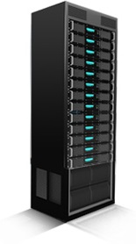
Server
Many people think of a server as just being a piece of hardware but they perform many important software tasks.
A server can be a very expensive high-end machine or it can be a standard desktop computer which is set up to act like a server.

Slide 23
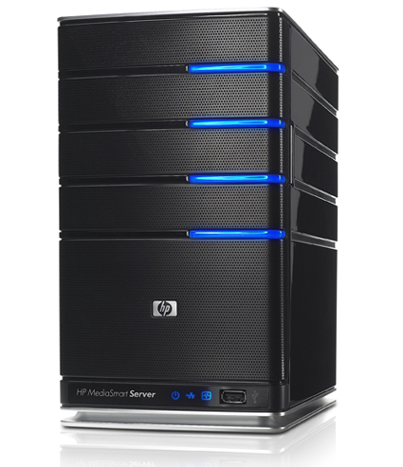
Types of Server
Use the internet to find out what the following types of server do:
File server
Print server
Mail server
Web server
Application server
Communication server
Write your answers in your own words and send them to your teacher in an email for marking.

Slide 24
Start Quiz

Slide 25
Rules
Split into teams with 5 or 6 people in each team.
When it is your team’s turn, pick a number from the board and your question will be revealed.
Answer the question. If the teacher thinks you answered the question correctly, you will get 2 points.
If you get it wrong, it can be answered by another team for 1 point.
The winning team is the team with the most points at the end of the quiz.

Slide 26
1
2
3
4
5
6
7
8
9
10
11
12
13
14
15
16
17
18
19
20

Slide 27
Question 1
What does a “hub” do on a network?
Back

Slide 28
Question 2
Describe the disadvantages of using a “ring” topology.
Back

Slide 29
Question 3
What is a peer-to-peer network?
Back

Slide 30
Question 4
Describe the difference between a client-server and a peer-to-peer network.
Back

Slide 31
Question 5
What does a “terminator” do on a network?
Back

Slide 32
Question 6
What does a “repeater” do on a network?
Back

Slide 33
Question 7
Describe two disadvantages of using a network.
Back

Slide 34
Question 8
Describe the difference between a LAN and a WAN.
Back

Slide 35
Question 9
Describe the advantages of using a “bus” topology.
Back

Slide 36
Question 10
What is meant by the term “peripheral”?
Back

Slide 37
Question 11
What does a “bridge” do on a network?
Back

Slide 38
Question 12
What does the “network interface card” do?
Back

Slide 39
Question 13
Describe the advantages of using a “ring” topology.
Back

Slide 40
Question 14
What does a “router” do on a network?
Back

Slide 41
Question 15
Describe the advantages of using a “star” topology.
Back

Slide 42
Question 16
Describe 3 tasks that a server can perform.
Back

Slide 43
Question 17
Describe the disadvantages of using a “star” topology.
Back

Slide 44
Question 18
What does a “switch” do on a network?
Back

Slide 45
Question 19
Describe the disadvantages of using a “bus” topology.
Back

Slide 46
Question 20
Why do companies set up networks?
Back

