Slide 1
Computer Networks
Lesson 1

Slide 2
Starter
Work in pairs and write down the advantages and disadvantages of using a computer network.

Slide 3
Objective of the Lesson
Define a computer network.
TBAT
Describe what a network is, the difference between a LAN and a WAN and identify three network topologies.
TBAT
Describe the advantages and disadvantages of networks and three network topologies.
To understand how to
Research and describe examples of real-life networks.

Slide 4
Homework
Everybody should complete the file that you start this lesson about networks. This can be a presentation, brochure or report.
Some of you may also want to get the extra marks performing some additional research about networks and by giving real life examples of where networks are used.
This homework is due in next lesson and should be emailed to your teacher for marking.
Make sure you have written your homework clearly in your planner.

Slide 5
What is a Computer Network?
A stand-alone computer is any computer which is not connected to another.
This used to be very common but people realised that computers work a lot better when they can communicate to other computers.
A network is two or more computers which are linked together so that they can share resources and data.

Slide 6
What are the Advantages of Using a Network?
They allow groups of users to share and exchange data quickly and easily and work collaboratively.
Centralised databases saved on a server can be shared, read and updated by all users on the network which allows all the users to have access to the latest data.
Networks allow the users to share hardware and software. This is cheaper and more efficient than purchasing a copy for each computer.
Viewing data across the entire network can allow managers to see the “whole picture” easily and make business decisions quickly.
Users can communicate with each other across the network.

Slide 7
What are the Disadvantages of Using a Network?
Building and maintaining a network requires specialist knowledge and many large organisation employ teams of technicians who design the networks and keep them running correctly.
Networks can allow unauthorised people to get access to sensitive data as the way the network is connected may allow access to the system. A large part of a technician’s job is protecting the company’s network from unauthorised access.
Users on a network may not use it responsibly and may use the network to look at inappropriate data or forget to log out once they have finished. All the users on the system need to agree to follow the company’s policies to ensure that security of the system is maintained.

Slide 8
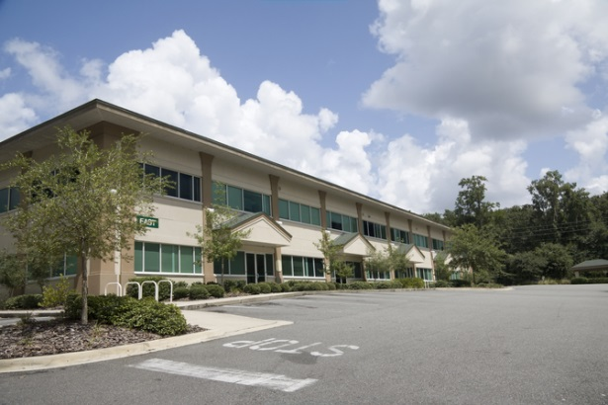
LAN and WAN
LAN (Local Area Networks) are small networks which are contained in a single building or small area.
WAN (Wide Area Networks) are larger networks over a wider geographical area.

Slide 9
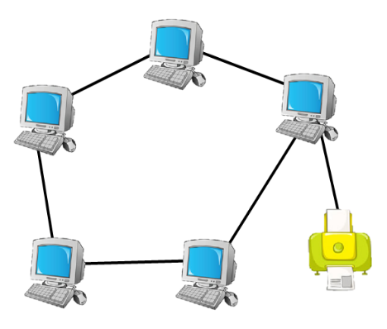
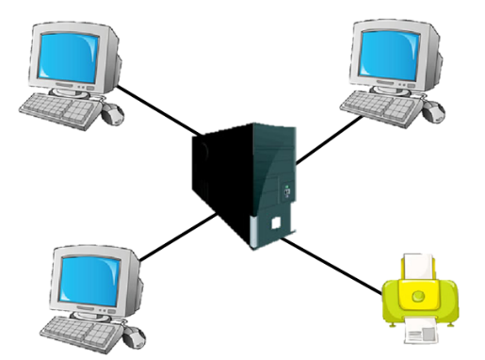
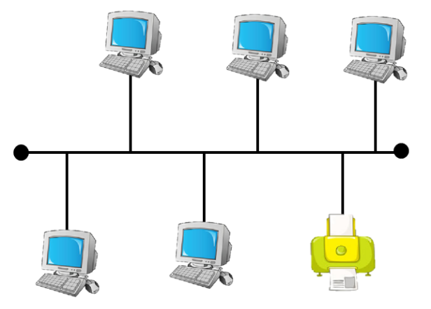
Network Topologies
“Topology” is the word used to describe the shape of a network.
There are three main LAN topologies:
Bus
Ring
Star

Slide 10
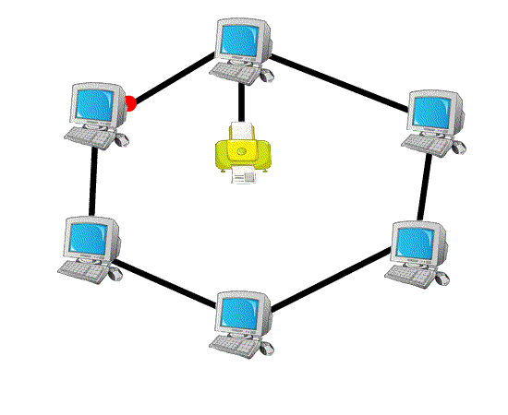
Ring
This is sometimes called the “Token-Ring” network.
A “Token” or “Packet” of data is passed around with the message.
Each computer reads to see if the message is for them and if it isn’t then it sends it on to the next computer.
When it reaches its destination, the recipient sends a message back to the sender to tell it that the message has been safely received.

Slide 11
Ring Topology
Disadvantages
This is the least secure as if one connection is lost, the whole network stops working.
If all the data is not traveling in the same direction then “Data Clashes” can occur and data can be lost.
If the data all moves in the same direction then it is slow and has to travel a long way to get to some computers.
Advantages
Uses the least amount of cabling and so is the cheapest and easiest to set up.

Slide 12
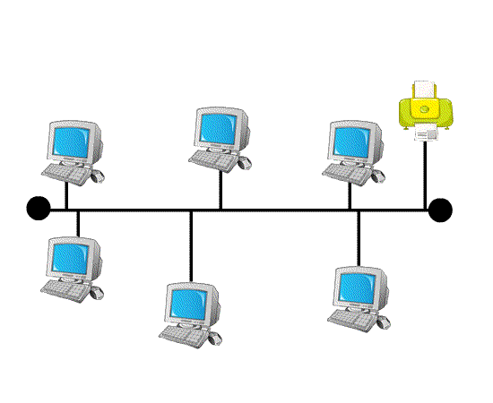
Bus Topology
A bus network has a single cable which all the computers and peripherals are attached to.
When one computer sends a signal along the wire, all the computers on the network receive the information, but only the one the message is addressed to accepts the information. The rest disregard the message.
A computer must wait until the bus is free before it can transmit a message.

Slide 13
Bus Topology
Advantages
Disadvantages
The bus is simple, reliable in very small networks, easy to use, and easy to understand.
It is easy to extend a bus.
If the central cable is broken then the whole network stops working.
Only one computer at a time can send a message; therefore, the number of computers attached to a bus network can significantly affect the speed of the network.

Slide 14
Star Topology
In a star topology, all the cables run from the computers to a central location, where they are all connected by a device called a hub.
There are two types of star network:
Broadcast star network – The hub sends the messages it receives from the computers to all the computers in the star and most of them ignore the message apart form the computer the message is addressed to.
Switched star network – The hub sends the message it receives only to the destination computer.

Slide 15
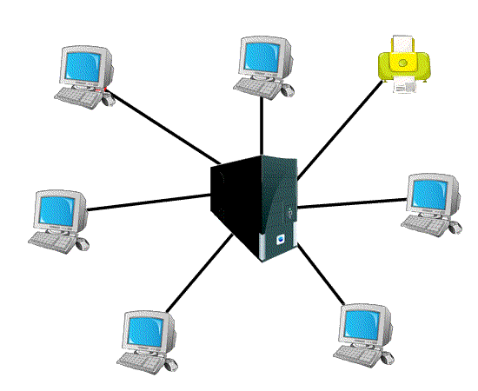
Star Topology
Advantages
Disadvantages
It is the fastest type of network as each computer has its own dedicated line and so avoids “Data Clashes”
If one cable is broken the rest of the network can still work without any delay.
New computers can easily be added to the network without disrupting the service to anybody else.
The network will stop working if the hub stops working.
It is expensive to set up as it uses the most cabling.

Slide 16
Your Task
Create a presentation, brochure or report about networks.
Explain what a network is and the advantages and disadvantages of using a network.
Describe the difference between a LAN and a WAN.
Describe the main features of common network topologies; Star, Bus and Ring.
Draw a diagram to represent each topology.
Outline the advantages and disadvantages of each topology.
You can use the internet to help you with your research but make sure you write the text in your own words.
Save the file with a suitable name and email this file to your teacher for marking.

Slide 17
Homework
Everybody should complete the file that you started this lesson about networks. This can be a presentation, brochure or report.
Some of you may also want to get the extra marks by performing some additional research about networks and by giving real life examples of where networks are used.
This homework is due in next lesson and should be emailed to your teacher for marking.
Make sure you have written your homework clearly in your planner.

