Slide 1
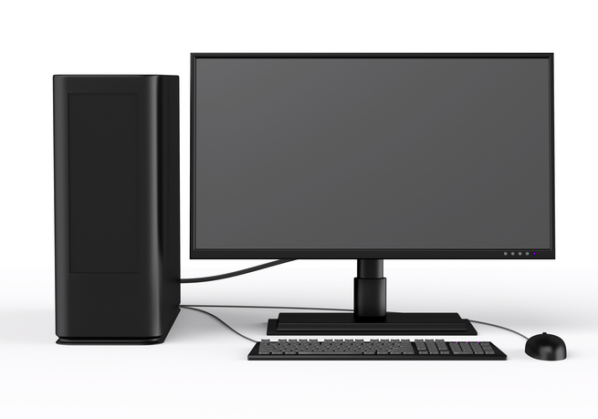
History of Computers

Slide 2
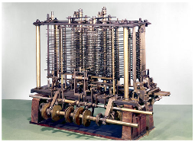
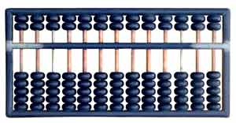
Starter
What do these two things have in common?

Slide 3
Objective of the lesson
Identify some of the key points in computer history.
All of you will:
Identify a few key points in the development of computers.
Most of you will:
Identify key people and explain what they did to help in the development of computers.
Put key events into the correct order in which they happened.
Some of you will:
Create a poster to show some of the key points in computer history.

Slide 4
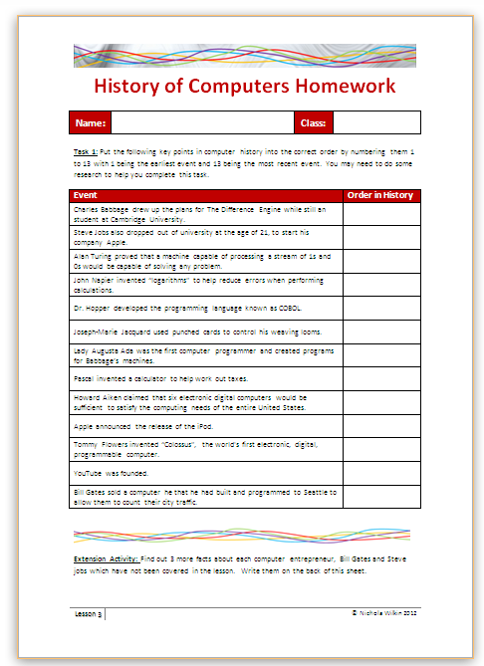
Homework
Everybody should complete Tasks 1 by putting key events of computer history into the correct order in which they happened.
Some of you may also want to get the extra marks by completing the extension activity.
This homework is due in next lesson.
Make sure you have written your homework clearly in your planner.

Slide 5
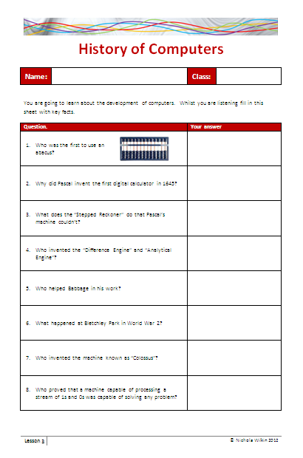
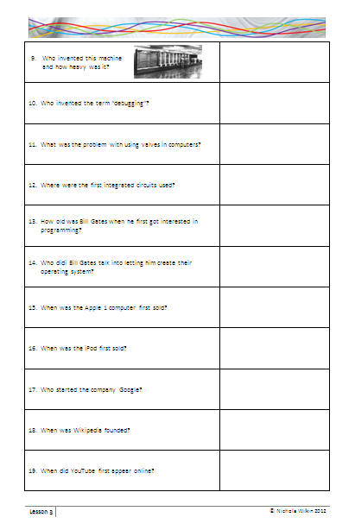
History of Computers
You are going to learn about the history of computers. While you are listening, fill in the handout to answer questions about the key points in the history.

Slide 6
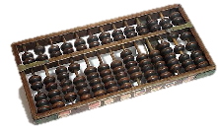
Over 5000 years ago…
The abacus was used in Babylon 2000 years before the Greeks used it to help with calculating. To use it, you slide the beads up and down on the rods to add and subtract. It is still used today in some countries.

Slide 7
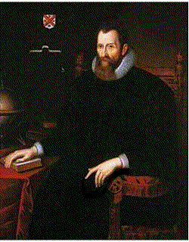
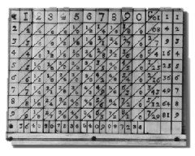
John Napier
John Napier invented “logarithms” which use lookup tables to find the solution to otherwise tedious and error-prone mathematical calculations.
I am a mathematician, physicist, astronomer and astrologer.
Clever clogs!

Slide 8
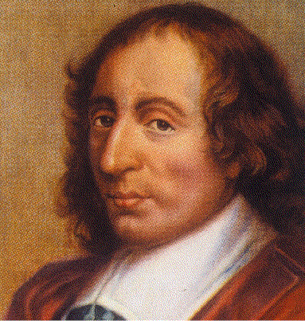
Blaise Pascal
This famous French philosopher and mathematician invented the first calculator in 1645 to help with collecting taxes. It could add and subtract by rotating dials.

Slide 9
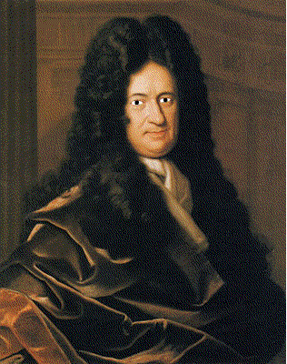
Gottfried Wilhelm von Leibnitz
Leibnitz invented a machine in 1674, around 30 years after Pascal invented his machine. He called it the “Stepped Reckoner” and it could not only add and subtract, but multiply and divide as well.

Slide 10
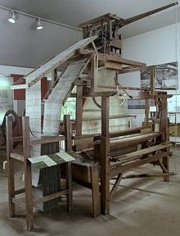
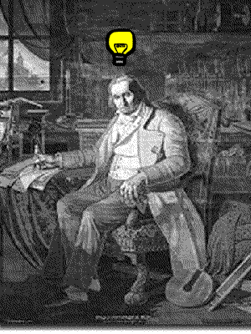
Joseph-Marie Jacquard
Joseph-Marie Jacquard was a weaver. In 1804, he got the bright idea of adapting the use of punched cards used in musical boxes to control his looms. His invention provided a model for the input and output of data in the electro-mechanical and electronic computing industry.

Slide 11
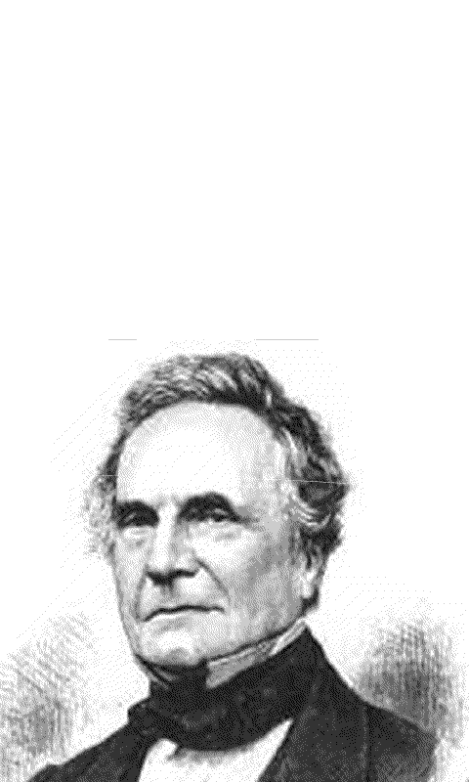
Charles Babbage
Charles Babbage designed the “Difference Engine” and “Analytical Engine” in the early 19th Century, which was the blueprint used in the invention of the modern electronic digital computer.

Slide 12
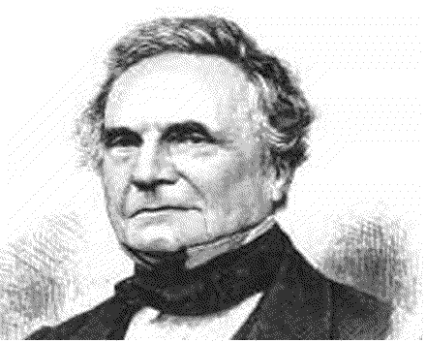
Charles Babbage
The Difference Engine was never fully built. Babbage drew up the plans for it while still a student at Cambridge University.
I also invented the cowcatcher, dynamometer, standard railroad gauge, uniform postal rates, occulting lights for lighthouses, Greenwich time signal, heliograph ophthalmoscope. But I HATE street musicians.
Another clever chap.

Slide 13
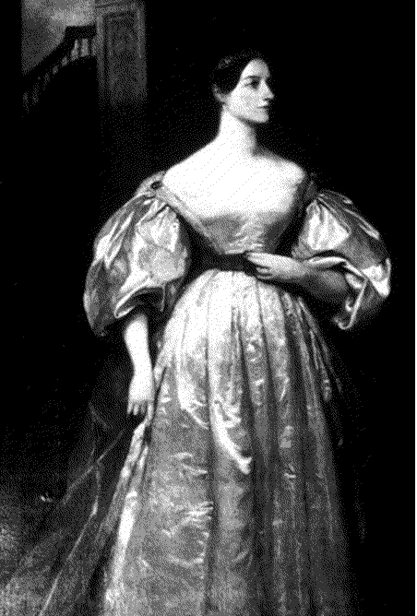
Lady Augusta Ada
She was the daughter of the famous romantic poet Lord Byron and she was a brilliant mathematician who helped Babbage in his work. She documented his work, which Babbage could never bother to do and also wrote programs to be run on Babbage’s machines. She is recognised as the first computer programmer.

Slide 14
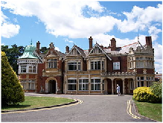
Bletchley Park
During World War 2, code breakers used computational analytical models to try and work out what enemy messages meant.

Slide 15
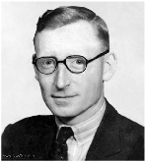
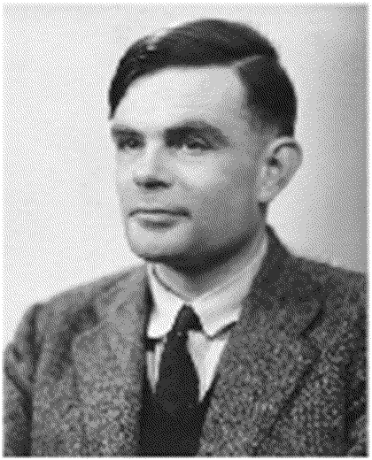
Bletchley Park
Two young engineers who met there were called...
and
Tommy Flowers
Alan Turing

Slide 16
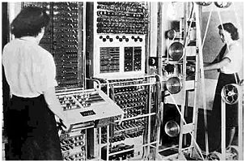
Tommy Flowers
Tommy Flowers invented a computer called Colossus which was the world's first electronic, digital, programmable computer.
It was HUGE.

Slide 17
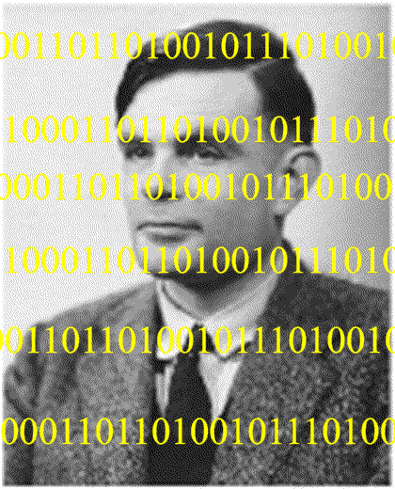
Alan Turing
Alan Turing published a paper called On Computable Numbers, with an application to the Entscheidungsproblem. The paper proved that a machine capable of processing a stream of 1s and 0s according to programmed instructions would be capable of solving any problem.

Slide 18
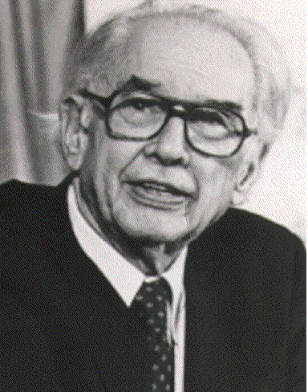
John Vincent Atanasoff
I invented the ABC, a digital computer, so-called because it processed data using 1s and 0s. Being binary, the data could easily be represented electronically since switches naturally have two states—on and off.

Slide 19
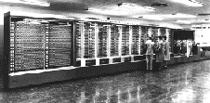
Howard Aiken
In 1944, while a professor of physics at Harvard, Howard Aiken was supported by IBM to build the ASCC computer (Automatic Sequence Controlled Calculator). The computer had mechanical relays (switches) which flipped backwards and forwards to represent mathematical data. It was huge and weighed 35 tons with 500 miles of wiring.

Slide 20
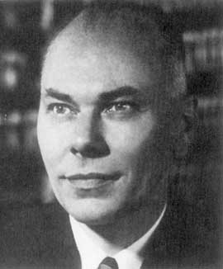
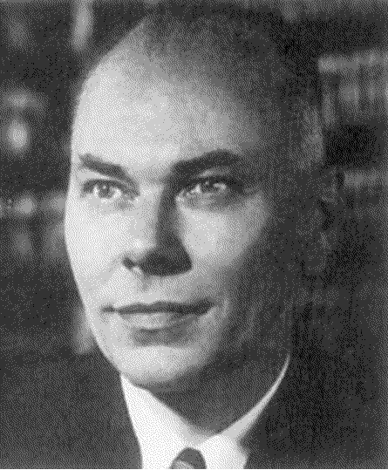
Howard Aiken
As computers were so large and were purpose built for each company, they tended to be very expensive. Howard Aiken was asked about the future of electronic computers. His answer was as follows…
I estimate that six electronic digital computers would be sufficient to satisfy the computing needs of the entire United States.

Slide 21
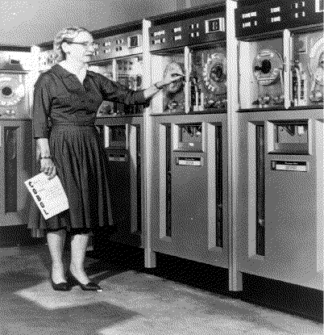
Dr. Grace Murray Hopper
Rear Admiral Dr. Grace Murray Hopper, worked with Howard Aiken from 1944 and used his machine for gunnery and ballistics calculation for the US Bureau of Ordnance’s Computation project.
Dr. Hopper greatly simplified programming by inventing the “COBOL” language which was the first programming language to use English for variable names and logical operations rather than machine code.

Slide 22
Dr. Grace Murray Hopper
She also invented the term “debugging” when a moth flew into the computer and caused an error.

Slide 23
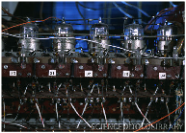
Valves
Computers used values which were very big and bulky and tended to overheat and blow up.
This made them unreliable.

Slide 24
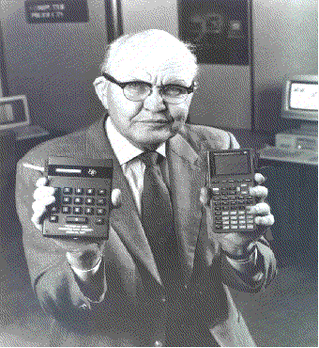
Jack Kilby
Jack Kilby invented the first integrated circuit in 1959, which meant computers could become smaller and more reliable.
These were first used inside calculators.

Slide 25
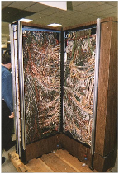
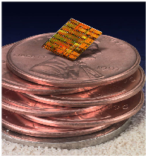
Microelectronics Revolution
The microelectronics revolution allowed the amount of hand-crafted wiring seen on the left to be mass-produced as an integrated circuit the size of your thumbnail.

Slide 26
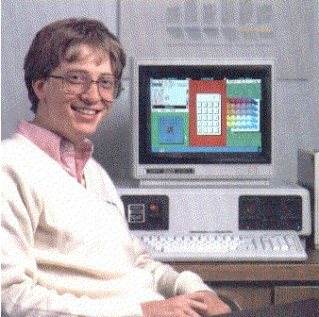
Bill Gates
At the age of 13 Bill Gates became interested in programming computers.
He sold a computer he built and programmed to Seattle to allow them to count their city traffic when he was still a teenager.

Slide 27
Bill Gates
Whilst at Harvard University he developed a programming language for his computer.
He decided to drop out of university so he could concentrate all his time writing programs for his computer and started a company called Microsoft to develop software for the newly emerging personal computer market.

Slide 28
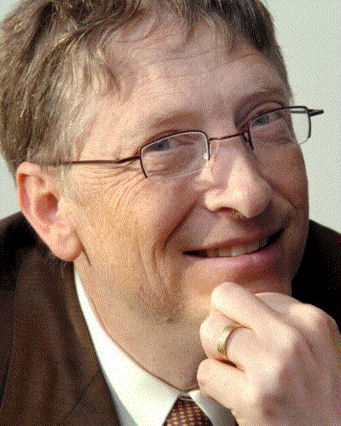
Bill Gates
Bill Gates managed to talk IBM into letting Microsoft make the operating system and Gates proceeded to make a fortune from MS-DOS.
Over the next few years he made billions of dollars and has donated a lot of his fortune to improving the lives of people in developing countries.

Slide 29
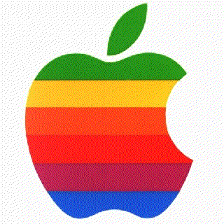
Steve Jobs
Steve Jobs also dropped out of university at the age of 21 to start his company Apple with another college dropout Steve Wozniak.

Slide 30
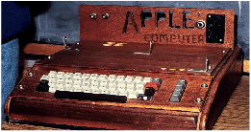
Apple
Glad to see things have changed slightly
In 1976 this “Apple I” was one of the first home computers and was sold for $600

Slide 31
Steve Jobs
$
$
$
The immense success of Apple 2 revolutionised the personal computer market with the invention of the Graphical User Interface (GUI) which made using the computer very user friendly.
This made Steve Jobs a millionaire at the age of 25.
$
$

Slide 32
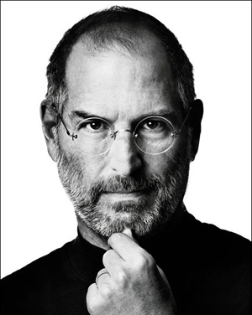
Steve Jobs
In 2000 digital music players were big and bulky or small but played terrible quality music.
Apple saw the opportunity and announced the release of the iPod in 2001, the first digital portable music player which changed the course of media entertainment and was followed with equal success by the iPhone and iPad.
1955 - 2011

Slide 33
Microsoft v Apple
In 1994 Apple took Microsoft to court to prevent them using the Graphical User Interface (GUI) components that Apple invented.
Apple didn’t win the case but Microsoft were told to change the “Trash can” icon on the desktop as it was too similar to Apple’s version.
Microsoft changed it to the Recycle Bin.
In 1998 Microsoft was valued at $344.6 billion and Apple was only $5.54 billion.
By 2011, Apple was valued at $346.7 billion whilst Microsoft was worth $214.3 billion. This was the first time that Apple had edged ahead.
This change is put down to the success of digital music players and smart phones.

Slide 34
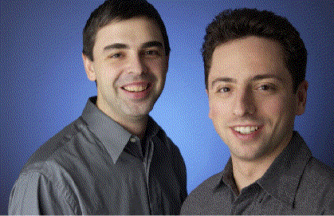
Larry Page and Sergey Brin
Larry Page and Sergey Brin met at Stanford University. They began to work on developing a search engine called “BackRub”

Slide 35
Google
They decide to rename BackRub to Google – a play on the word “googol” a mathematical term for the number 1 followed by 100 zeros.
This was to show that it was their mission to organise the seemingly infinite amount of information on the internet.

Slide 36
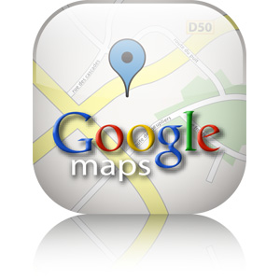
Google
From a small company that started in a garage to one of the world’s largest companies with many diverse areas such as its own email system known as Gmail, Google Maps and Google Books.
On average, Google has been acquiring a company a week since 2010 including YouTube, Motorola Mobility and Android.
In 2011 Google was estimated to be worth $185.1 billion.

Slide 37
Key points in modern computing history
1984: Apple introduces the Macintosh computer
1990: Microsoft introduces Windows 3.0
1992: Microsoft introduces Windows 3.1
1996: BackRub was created and launched onto Stamford Universities’ servers
1997: BackRub given a new home and changed to the name Google.
2000: Bill Gates relinquishes his title as head of Microsoft and Microsoft Windows 2000 was released
2001: Wikipedia was founded
2001: Microsoft Windows XP is released
2005: Google purchases Android
2005: YouTube was founded and appears online
2006: Google buys YouTube
2006: Nintendo releases the Wii
2007: Apple introduces the iPhone
2007: Microsoft releases Microsoft Windows Vista and Office 2007
2010: Apple introduces the iPad

Slide 38
Your answers…
As you were listening to the presentation you should have been filling in the handout.
We will now go through your answers.

Slide 39
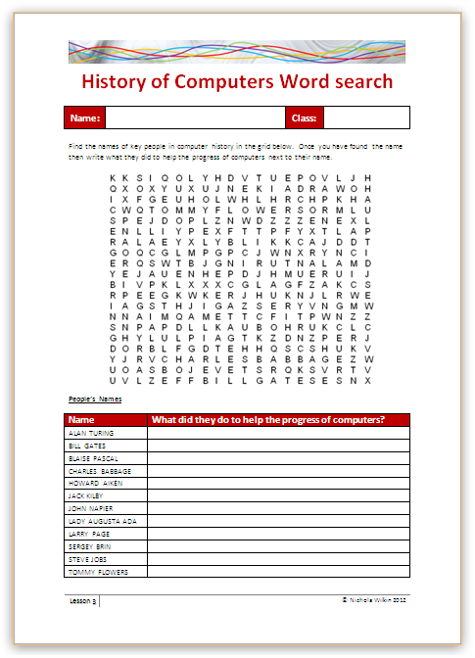
Word Search
Complete the word search by finding the hidden names in the grid of key people listed at the bottom of the sheet. When you find their name in the grid, write a description of what they did next to their name.
You may use the internet to help you write the descriptions if you wish.

Slide 40
Extension Activity
Create a poster showing the key points in the development of computers. Use the internet to bring in images of the people involved and the main inventions which helped to shape computing today.

Slide 41
Plenary
You are going to play a game of Guess Who.
I need one volunteer who will sit with their back to the board and will ask questions to the rest of the class to try and guess who is showing on the screen.
They are only allowed to ask questions with a “Yes” or “No” answer.
No peeking!

Slide 42
Guess who this is…
Name: Steve Jobs
What was he famous for? Developed the Apple Brand.
When did this happen? 1970s
Nationality: American

Slide 43
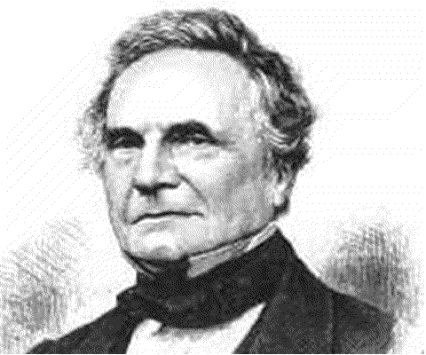
Guess who this is…
Name: Charles Babbage
What was he famous for? He designed the “Difference Engine” and “Analytical Engine”
When did this happen? In the early 19th Century.
Nationality: English

Slide 44
Guess who this is…
Name: Alan Turing
What was he famous for? Proved that a machine capable of processing a stream of 1s and 0s would be capable of solving any problem
When did this happen? 1940s
Nationality: English

Slide 45
Guess who this is…
Name: Dr. Grace Murray Hopper
What was she famous for? Inventing the “COBOL” language and the term “debugging”.
When did this happen? 1940s
Nationality: American

Slide 46
Guess who this is…
Name: Blaise Pascal
What was he famous for? Invented the first calculator to help with collecting taxes.
When did this happen? 1645
Nationality: French

