Slide 1
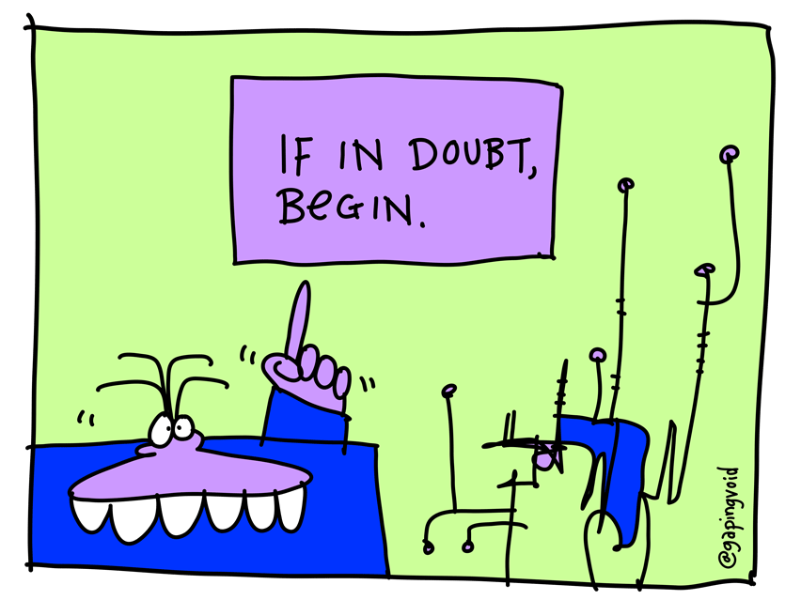
GCSE Computing revision: A451 Written exam.
Computer systems | Hardware | Software | Data representation | Databases | Networks & The Internet | Programming

Slide 2
Revision resources.
Includes everything you need to know for the written exam.
http://www.cambridgegcsecomputing.org/new-course
http://www.bbc.co.uk/education/subjects/z34k7ty
http://www.teach-ict.com/gcse_computing/ocr/GCSE_A451_topics.html
Available from

Slide 3
Hardware

Slide 4
Hardware keywords
Keyword | Definition
CPU
Fetch-execute cycle
Clock speed
Number of cores
Cache memory
RAM
Volatile memory
ROM
Non-volatile memory
Logic gates

Slide 5
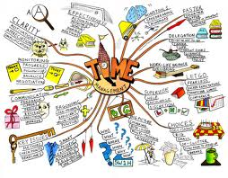
Hardware
CPU – Fetch-execute cycle | CPU - Boot sequence | CPU - Clock speed | CPU – Cache memory | CPU – multi-core processors | Memory – RAM vs ROM | Virtual memory vs. Flash memory | Binary logic (logic gates & truth tables) | Input & Output devices | Secondary storage.

Slide 6
Past paper exam questions.
2011 past paper.

Slide 7
Past paper answers.
2011 past paper.
Notes: What do I need to improve?
Notes:
7

Slide 8
Past paper answers.
2011 past paper.
Notes: What do I need to improve?
Notes:
8

Slide 9
Past paper exam questions.
2011 past paper.

Slide 10
Past paper exam questions.
2011 past paper.
Notes:
10

Slide 11
Past paper answers.
2011 past paper.
Notes: What do I need to improve?
Notes:
11

Slide 12
Past paper answers.
2011 past paper.
Notes: What do I need to improve?
Notes:
12

Slide 13
Past paper exam questions.
2012 past paper.
Notes:
13

Slide 14
Past paper exam questions.
2012 past paper.
Notes:
14

Slide 15
Past paper answers.
2012 past paper.
Notes: What do I need to improve?
Notes:
15

Slide 16
Past paper answers.
2012 past paper.
Notes: What do I need to improve?
Notes:
16

Slide 17
Past paper exam questions.
2013 past paper.
Notes:
17

Slide 18
Past paper answers.
2013 past paper.
Notes: What do I need to improve?
Notes:
18

Slide 19
Software

Slide 20
Software keywords
Keyword | Definition
System software
Application software
Operating system
Utility software
Defragmentation
Disk clean-up
Open source software
Custom written software
Proprietary software
Off the shelf software

Slide 21
Software
System software | User interface software | Memory management | Files & directories | Security | Programming software | Applications & utilities | Custom written, Off the shelf, Open source & Proprietary software.

Slide 22
Past paper exam questions.
2011 past paper.

Slide 23
Past paper answers.
2011 past paper.
Notes: What do I need to improve?
Notes:
23

Slide 24
Past paper answers.
2011 past paper.
Notes: What do I need to improve?
Notes:
24

Slide 25
Past paper exam questions.
2011 past paper.
2011 past paper answers.
Notes: What do I need to improve?

Slide 26
Past paper exam questions.
2012 past paper.
2012 past paper answers.
Notes: What do I need to improve?
Notes:
26

Slide 27
Past paper exam questions.
2013 past paper.
2013 past paper answers.
Notes: What do I need to improve?
Notes:
27

Slide 28
Data representation
Revision tip: Focus on the things you find difficult first.

Slide 29
Data representation keywords
Keyword | Definition
Binary (base 2)
Denary (base 10)
Hexadecimal (base 16)
Character set
ASCII
Unicode
Image resolution (images)
Colour depth (images)
Sampling interval (sound)
Sampling rate (sound)
Operand (instructions)
Op-code (instructions)
Meta-data

Slide 30
Data representation
Binary number conversion | Hexadecimal number conversion | Characters | Images | Sound | Instructions.

Slide 31
Past paper exam questions.
2011 past paper.

Slide 32
Past paper answers.
2011 past paper.
Notes:
32

Slide 33
Past paper exam questions.
2011 past paper.
Exam tip: When converting numbers in exam questions make sure
you show your workings.

Slide 34
Past paper answers.
2011 past paper.
Notes: What do I need to improve?
Notes:
34

Slide 35
Past paper exam questions.
2012 past paper.
Notes:
35

Slide 36
Past paper answers.
2012 past paper.
Notes: What do I need to improve?
Notes:
36

Slide 37
Past paper exam questions.
2013 past paper.
Notes:
37

Slide 38
Past paper answers.
2013 past paper.
Notes: What do I need to improve?
Notes:
38

Slide 39
Databases.
Start of lesson
End of lesson
Lesson 1
Lesson 2
Lesson 3
Revision tip: Focus on the things you find difficult first.

Slide 40
Databases.
Revision tip: Focus on the things you find difficult first.

Slide 41
Database keywords
Keyword | Definition
Database
Entity
Table
Primary key
Foreign key
Flat file database
Relational database
Validation
Verification
DBMS (Database management system)

Slide 42
Past paper exam questions.
2011 past paper.

Slide 43
Past paper answers.
2011 past paper.
Notes: What do I need to improve?
Notes:
43

Slide 44
Past paper exam questions.
2011 past paper.

Slide 45
Past paper answers.
2011 past paper.
Notes: What do I need to improve?
Notes:
45

Slide 46
Past paper exam questions.
2012 past paper.
Long answer question.
@CES_teach
Notes:
46

Slide 47
Past paper answers.
2012 past paper.
Notes: What do I need to improve?
Notes:
47

Slide 48
Past paper exam questions.
2013 past paper.
Notes:
48

Slide 49
Past paper answers.
2013 past paper.
Notes: What do I need to improve?
Notes:
49

Slide 50
Networks & the internet.
Revision tip: Focus on the things you find difficult first.

Slide 51
Networks & the internet keywords
Keyword | Definition
Topology
Client-server network
Peer-to-peer network
Router
Server
Switch
HTML
Protocol
Lossy compression
Lossless compression

Slide 52
Networks
Network hardware | Types of network (client-server vs. peer-to-peer) | Network topologies | Network protocols | Network security | The Internet (DNS Servers) | HTML | Internet file standards | File compression (lossy vs. lossless)

Slide 53
Past paper exam questions.
2011 past paper.

Slide 54
Past paper answers.
2011 past paper.
Notes: What do I need to improve?
Notes:
54

Slide 55
Past paper exam questions.
2011 past paper.

Slide 56
Past paper answers.
2011 past paper.
Notes: What do I need to improve?
Notes:
56

Slide 57
Past paper exam questions.
2012 past paper.
Notes:
57

Slide 58
Past paper answers.
2012 past paper.
Notes: What do I need to improve?
Notes:
58

Slide 59
Past paper exam questions.
2013 past paper.
Notes:
59

Slide 60
Past paper answers.
2013 past paper.
Notes: What do I need to improve?
Notes:
60

Slide 61
Programming revision
Revision tip: Focus on the things you find difficult first.

Slide 62
Programming keywords
Keyword | Definition
High level programming language
Low level programming language
IDE (Integrated development environment)
Sequence
Selection
Iteration
Variable
Constant
Compiler
Interpreter

Slide 63
Programming
Flowcharts | Pseudo-code | Programming languages | IDE (Integrated development environment) | Control flow (sequence, selection & iteration) | Variables & constants | Data types (string, integer, float, boolean) | Comparison operators (< > == >< e.t.c.) | Arrays | Testing

Slide 64
Past paper exam questions.
2011 past paper.

Slide 65
Past paper answers.
2011 past paper.
Notes: What do I need to improve?
Notes:
65

Slide 66
Past paper exam questions.
2012 past paper.
Notes:
66

Slide 67
Past paper exam questions.
2012 past paper.
Notes:
67

Slide 68
Past paper answers.
2012 past paper.
Notes: What do I need to improve?
Notes:
68

Slide 69
Past paper answers.
2012 past paper.
Notes: What do I need to improve?
Notes:
69

Slide 70
Past paper exam questions.
2013 past paper.
Notes:
70

Slide 71
Past paper exam questions.
2013 past paper.
Notes:
71

Slide 72
Past paper answers.
2013 past paper.
Notes: What do I need to improve?
Notes:
72

Slide 73
Past paper answers.
2013 past paper.
Notes: What do I need to improve?
Notes:
73

